Slide 1


Olympic
Data Analysis

Slide 2

Agenda
Introduction
Abstract
Problem Definition
Objectives
Introduction to SQL
Analysis on Olympic Data Using SQL
Insights

Slide 3


Introduction
The Olympic Games, as a global sporting event, offer a rich dataset encompassing information on athletes, countries, sports, and performances. This project aims to explore historical Olympic data using SQL to uncover trends and insights related to participation, performance, and growth across nations and sports. With SQL's robust querying capabilities, we can handle large datasets efficiently and extract meaningful patterns.

Slide 4



Abstract
The Olympic Games showcase global sportsmanship and national athletic achievement. However, analyzing such extensive data manually is time-consuming and inefficient. This project leverages SQL to process and analyze Olympic data, enabling the identification of top-performing countries, popular sports, medal distribution, and participation trends over time. The findings will contribute to understanding global sporting dynamics and nation-wise progress.

Slide 5

Problem Definition
Difficulty in manually extracting insights from large Olympic datasets.
Lack of clarity in which countries or athletes dominate particular sports/events.
Need for systematic tracking of participation and medal trends over time.
Identification of key contributors to Olympic success (countries, sports, athletes).

Slide 6

Objectives
Use SQL to manage, query, and analyze the Olympic dataset.
Identify the most successful countries and athletes.
Determine popular sports and events based on participation and medals.
Visualize medal trends over time and gender participation.
Gain insights into the evolution of Olympic performances across nations.

Slide 7
Introduction to SQL
Structured Query Language (SQL) is a standard language used to communicate with relational databases. SQL is especially powerful for performing operations such as:
Data Retrieval: SELECT, WHERE, GROUP BY, ORDER BY
Data Filtering and Aggregation: Using HAVING, DISTINCT, COUNT, AVG, SUM
Joining Tables: Combining multiple data sources via JOIN, INNER JOIN, LEFT JOIN
Advanced Queries: Using CTEs, Subqueries, and Window Functions for ranking and trend analysis

Slide 8
Analysis on Olympic Data Using SQL

Slide 9
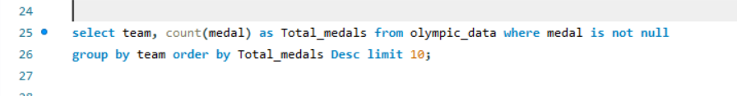
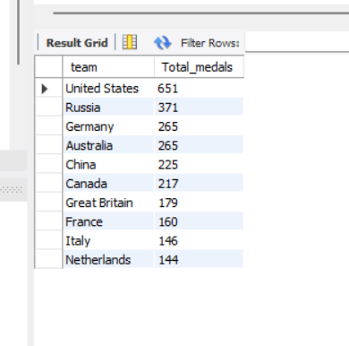
Top Countries by Total Medals

Slide 10
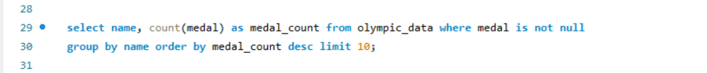
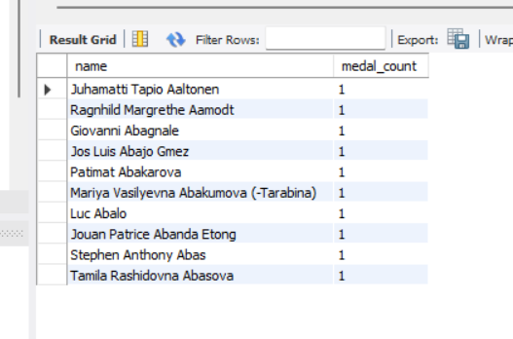
Top Athletes by Number of Medals

Slide 11

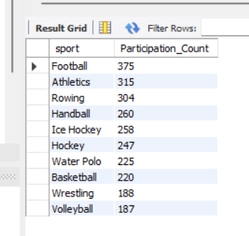
Most Popular Sports

Slide 12
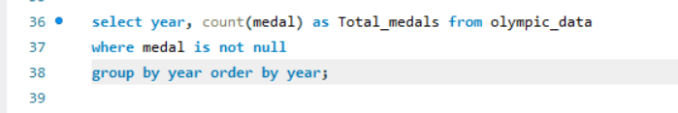
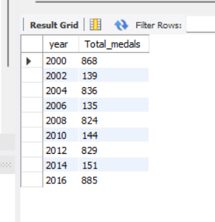
Medal Trends by Year

Slide 13

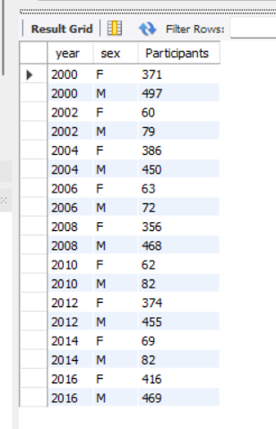
Gender Participation Over Time

Slide 14
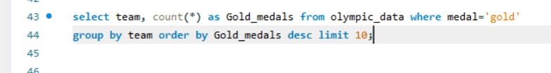
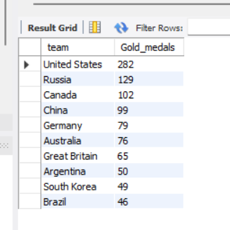
Countries with Highest Gold Medals

Slide 15
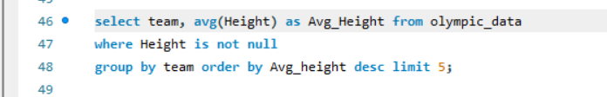
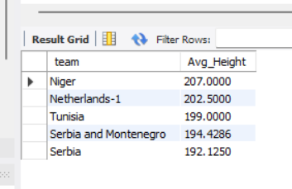
Countries with the Highest Average Athlete Height

Slide 16

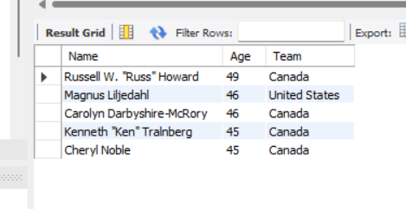
Oldest athletes in the data

Slide 17
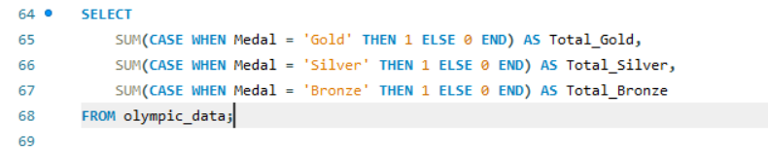
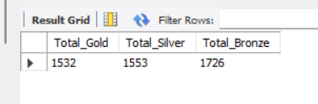
Sum of Gold, Silver, and Bronze medals separately

Slide 18
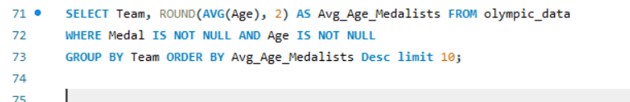
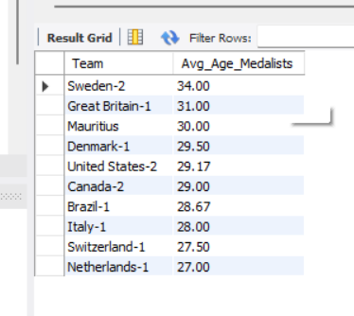
Average Age of Medal Winners per Country

Slide 19
Insights
Top Performing Countries: The United States (USA) dominates the medal tally across all editions, followed by countries like the Soviet Union, Great Britain, and China.
Popular Sports: Athletics and Swimming are the most participated and medal-rich sports.
Gender Participation: Over time, female athlete participation has increased significantly, especially after 2000, showing growing gender equality in global sports.
Medal Trends: The total number of medals and participating athletes has steadily increased across decades, highlighting the expanding global reach of the Olympics.
Age Insights: The youngest medalists are often from Gymnastics, while the oldest competitors tend to participate in Shooting and Equestrian events

Slide 20

THANK YOU!

